Slide 1
Framework for Recognition
Work in Progress
Jan Wiegers
International Association
for Educational Assessment

Slide 2
Content
Cause
Purpose
Approach
Work in progress: the framework for an examination organisation
The personnel
The key operational processes
Self-evaluation of own processes against three well established criteria
Discussion
Call for contributions at the 2019 IAEA conference

Slide 3
Cause
The need for an international standard: set of benchmarks of good practice to increase the trust and confidence from stakeholders
Discussion in 2016 IAEA conference Cape Town: how to improve the support from IAEA for their members
A practical framework for operational contexts

Slide 4
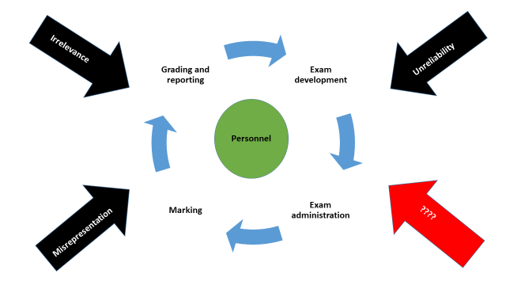
Diagram describing the framework

Slide 5
The framework
About the people who contribute to the work of an examination organisation.
The key operational processes that are used during an examiniation cycle:
Exam development
Exam administration
Marking
Grading and reporting
Self-evaluation against three criteria presented as types of threat:
Irrelevance
Misrepresentation
Unreliability
Another type

Slide 6
Section 1: Personnel
An examination organization should ensure that it meets these four criteria:
Senior officers are suitable for their role: personal and professional integrity: honest, trustworthy and dependable and demonstrating sound moral and ethical principles
Some have an advanced training in educational assessment
Some have an advanced training in business management
A workforce of appropriate size, adequately staffed to ensure the delivery of both academic and administrative outcomes. Has academic, managerial, administrative and psychometric expertise.

Slide 7
Personnel (continued)
Adequate training for its people: monitoring and evaluating this (remains fit for its purpose and effective). And plans ensuring readiness for future changes.
It has quality assurance and business continuity processes: regurlarly reviewed, updated and audited.

Slide 8
Personnel (continued)
An overview has been developed describing the necessary functions in organizations running large-scale assessments and its specific professional requirements.
Some mentioned:
Chief executives
Senior executives / psychometrician
Managers / subject specialist
Chief examiner
Item writer
Assessor

Slide 9
Section 2: Operational Processes
Exam development
Exam administration
Marking
Grading and Reporting

Slide 10
Section 3: Evaluation
Procedures to ensure that assessments are of suitable quality
Evaluation of processes against well established criteria:
Relevance
Representation
Reliability
Areas, relevant to its particular context should be identified and prioritised and evidence collected, deemed relevant and sufficient.
If so, an organization will be better prepared to take action to mitigate identified threats and back-up arrangements and contingency plans

Slide 11
Section 3: Evaluation (continued)
Not all threat types may be relevant in every situation
The IAEA working group worked out some examples (see full paper for all of them)
Each example was developed by taking one aspect of a process described in section 2, considering the three types of threats
For example:
A threat for a 50-item MC exam, taken on screen, may not be a threat to a 3 hour written essay paper.
Exam development: does the blueprint under or over represents parts of the syllabus
Exam administration: does insufficient training or incompetent invigilator behaviour affect the standardized conduct of examination and so compromise the reliabilty of student performance?

Slide 12
CONCLUSION
The framework for recognition is an very important and indispensable instrument for every exam organization in the world
The IAEA wants to take the lead in giving support to its members by developing the framework
BUT: it can only be done by the active participation of the IAEA members
Join the upcoming IAEA conference in Azerbaijan (22-27 sSeptember) and take part in the discussions about this framework.

Slide 13
Thank you

